Slide 1
PRIORITIES, PROGRESS, PARTNERSHIPS
GNWT Updates to NATA
April 10, 2013

Slide 2
PRIORITIES
Maximizing Infrastructure Investment
Quality Assurance, Emergency Planning and Continuous Improvement
Community Capacity Building
Regulatory Reform
Balancing Stakeholder Needs
Notes:
Protecting, securing, addressing Climate Change issues, looking to future developments, remaining flexible

Slide 3
PROGRESS
Status of SMS
New and Improved Infrastructure
Community Capacity Building
Regulatory Reform

Slide 4
Safety Management Systems
Airports Division has SMS policies, processes, procedures and systems in place for Certified Airports
16 of the 19 initial audits have been completed
The remaining 3 are scheduled for completion by July 2013
Emergency exercise cycle is on round no. 2 with exercises in Fort Smith, Tulita, Gameti, Paulatuk and Fort McPherson
TC Assessments Planned for 8 communities in August

Slide 5
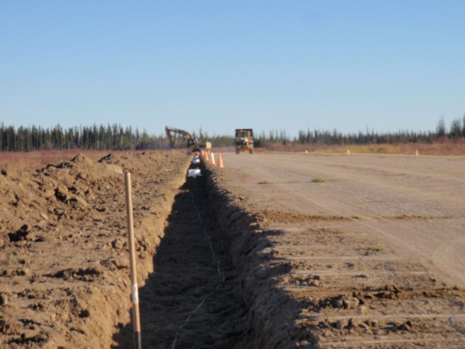
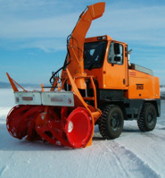
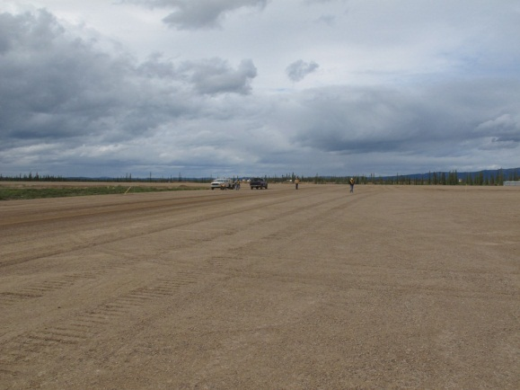
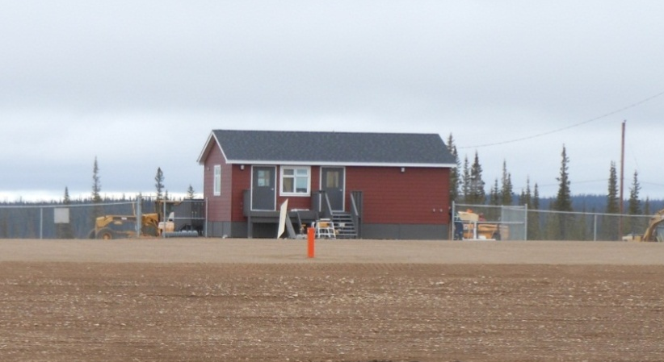
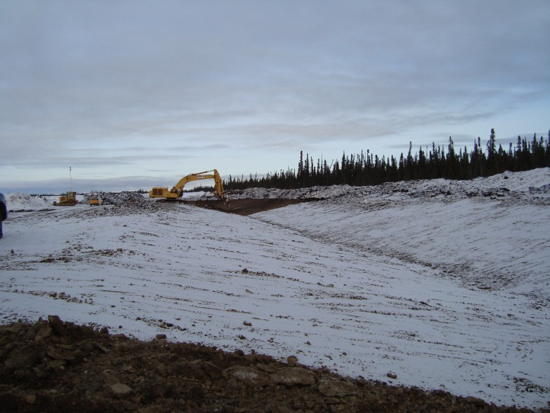
Infrastructure Improvements
Notes:
New runway at Colville Lake, the first new runway in over 15 years, including passenger shelter
Work is ongoing at runway in Trout Lake
New lighting at Jean Marie River, all airports now have fixed lighting
YZF Snowblower
New Transfer Switch Yellowknife Airport
Norman Wells heating and siding

Slide 6
Community Capacity Building
1st round of Emergency Exercises have now been completed at all sites
Identified some challenges and some ways to move forward
Increasing engagement of industry, community, GNWT and other levels of government in exercises
Notes:
Spent a lot of focus on this, recognition that it is a building process, can create an unbalanced system if it becomes overwhelmed
Resulting in very tangible results, growth opportunities, increased engagement

Slide 7
Regulatory Reform
Presentation to Senate Standing Committee of Transportation
Teleconference with Minister Fletcher, who has expressed interest in travelling to the North
Issues and Irritants Response
RESAs
Notes:
A number of areas of focus

Slide 8
PARTNERSHIPS
BCP, ACAP
Regulatory Reform
Course opportunities, engagement in exercises and outreach
NAV Canada
Air carries/tenants
Other Stakeholders
Notes:
As everyone, we work best as a team

Slide 9

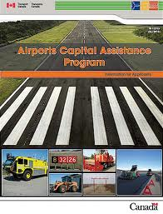
BCP, ACAP
Notes:
One of our favourite partnership, we appreciate the ongoing support of ACAP and BCP and are pleased with the renewal of the BCP with a longer timeframe
In recent years, this partnership has led or is leading to to the 3 air terminals, 2 new runways, CSB, the future Yellowknife Snowblower
We look forward to many more opportunities

Slide 10
Regulatory Reform
Where do we need to be
Harmonization of cycles
One size fits all/prescriptive regulations doesn’t work in the North
Risk based approaches/risk management
Roles and Responsibilities
Resources (funding/people) for new requirements
Notes:
Appreciate the collaboration and aligning of messaging where appropriate
One clear message is our goals are the same but approach/focus needs to consider the size, location, and traffic volumes
Should we be asking ourselves how is safe defined? Do we need some flexibility in approach? Are we missing out on some flexibility that is currently permitted because we are being too prescriptive?
For example, yesterday we touched only on the 1 year process for scheduled flights into registered airports yet CARs 302.01 permits scheduled flights to depart from registered airports with Minister approval, with conditions, is 1 year the only allowable condition?

Slide 11
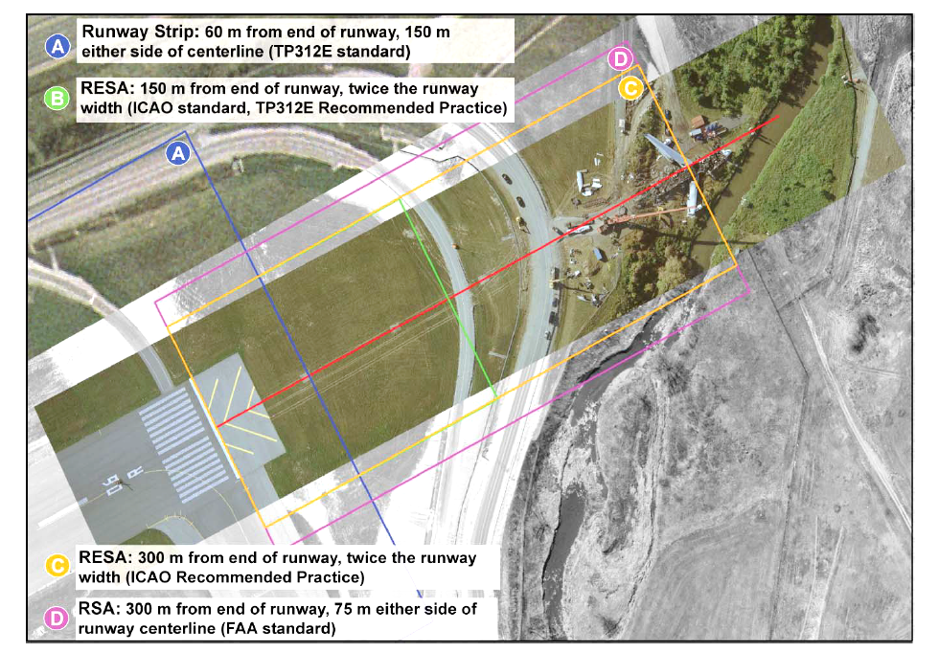
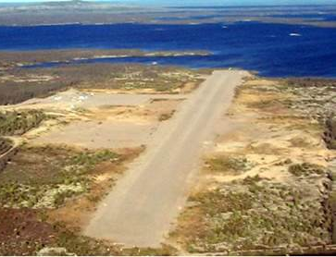
Regulatory Reform
Gameti
Toronto Pearson
Notes:
Good example of how the one size fits all approach may not

Slide 12
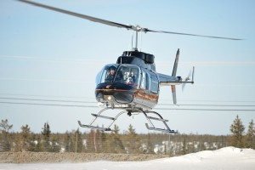
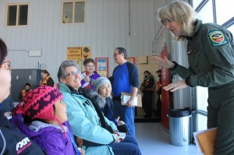
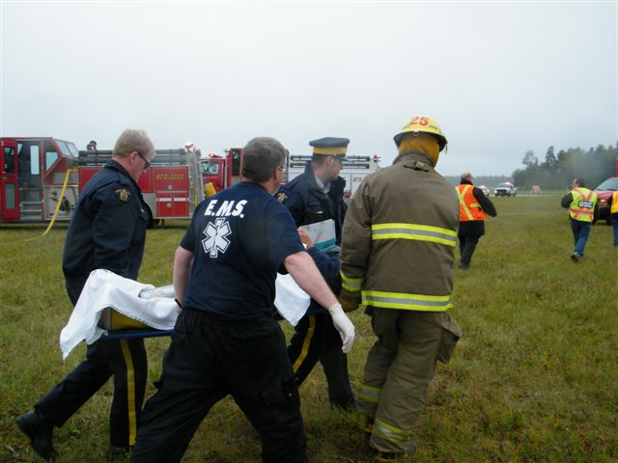
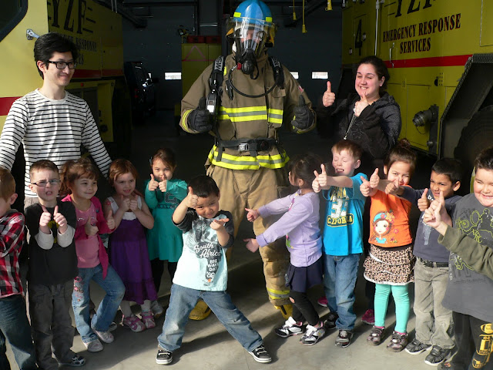
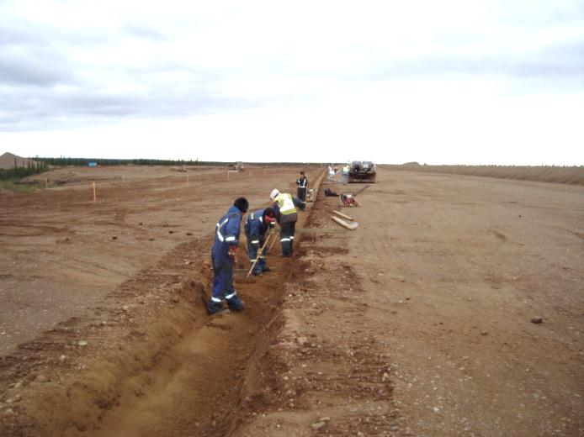
Training Outreach and Involvement
Notes:
Girls Fly Too/Outreach
Community Training for construction and operations and maintenance
Exercise Training/Engagement – seeing great uptake in involvement with focus on leaving positive impact in the community

Slide 13
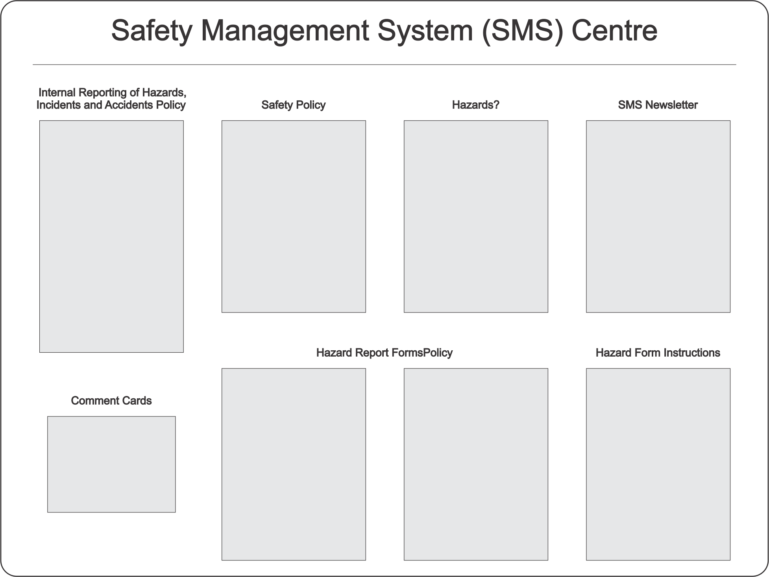
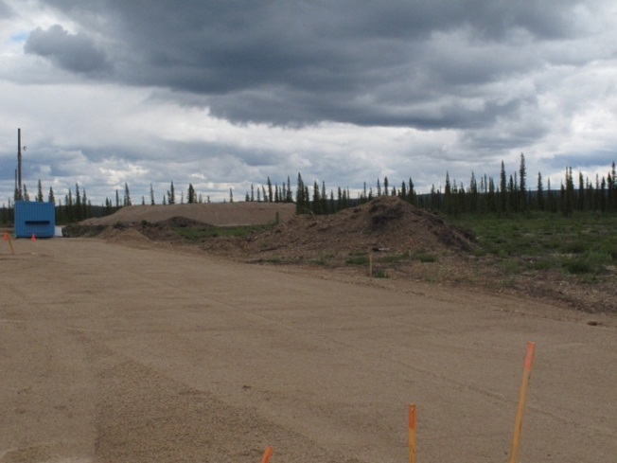
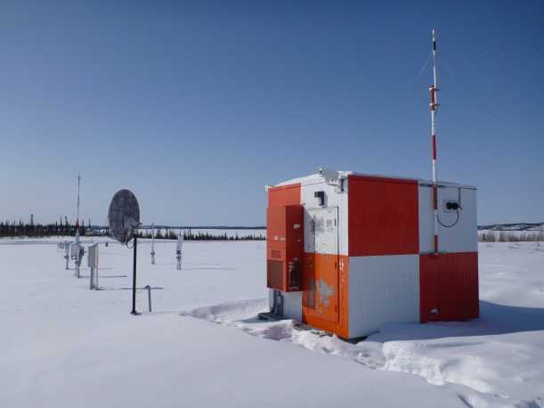

Balancing Stakeholder Needs
Notes:
Important to keep us apprised of changes in operations, not everything will work at the airports and things will take time
Timing – share information early
Important to consider domino impacts in operational changes, how does this impact existing infrastructure, adjacencies
Who should be taking the lead, many players – am I approaching the best player
SMS Board
AWOS – Colville Lake and Wekweeti
GNSS RNAV approaches
Grooving – climate change, results showing unexpected results

Slide 14
THANK YOU

